Slide 1
Understanding Microaggressions: Workshop for the History Faculty
Ross Wantland
Office of the Vice Chancellor for Diversity, Equity & Inclusion

Slide 2
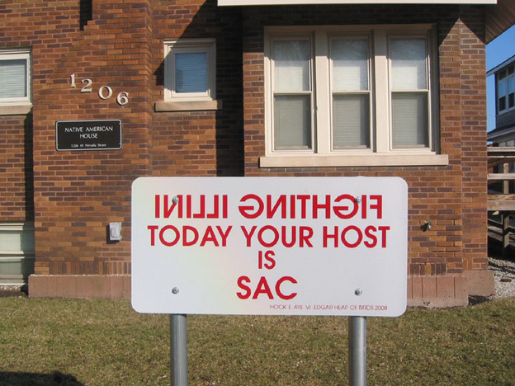
Land Acknowledgment
We are on the lands of the Peoria, Kaskaskia, Piankashaw, Wea, Miami, Mascoutin, Odawa, Sauk, Mesquaki, Kickapoo, Potawatomi, Ojibwe, and Chickasaw Nations.
These lands were the traditional territory of these Native Nations prior to their forced removal; these lands continue to carry the stories of these Nations and their struggles for survival and identity.
Pictured: Beyond the Chief exhibit by Hock E Aye Vi Edgar Heap of Birds

Slide 3
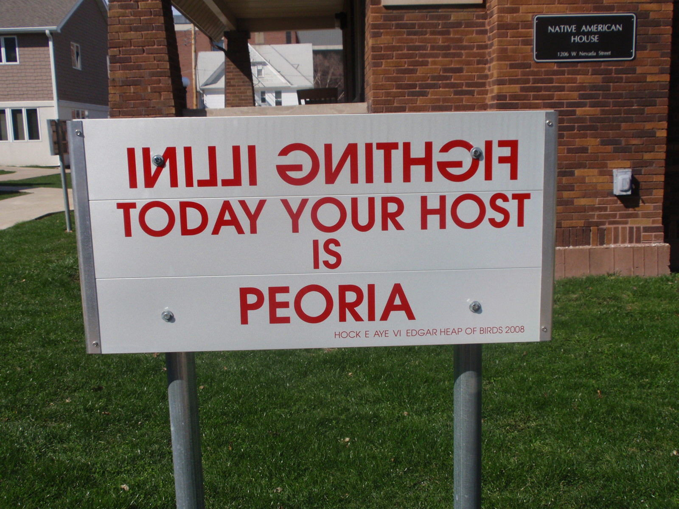
Land Acknowledgment
“[Land] acknowledgement is a way that people insert an awareness of Indigenous presence and land rights in everyday life. It can be a subtle way to recognize the history of colonialism and a need for change in settler colonial societies.” (Native-Land.ca)
Whose land are you on?
Visit native-land.ca to learn more
Pictured: Beyond the Chief exhibit by Hock E Aye Vi Edgar Heap of Birds

Slide 4
Introductions
In the Jamboard, write a post it note with your name and one thing you’d like to get out of today’s conversation

Slide 5
Today’s Goals
Understanding microaggressions in academic and co-curricular spaces
Identify personalized strategies for addressing microaggressions

Slide 6
Assumptions and Agreements
Racism, sexism, ableism, classism, antisemitism, and other forms of oppression harm our communities
These materialize interpersonally and systemically
We have all been impacted by these systems
We must come together to resolve these issues
We can best speak from our own individual experiences

Slide 7
Defining Microaggressions
In the chat:
What do you know about microaggressions?
What do you wish you knew?

Slide 8
Understanding Microaggressions
Commonplace verbal or behavioral indignities, whether intentional or unintentional, which communicate hostile, derogatory, or negative racial [and/or other identities] slights and insults
(D.W. Sue, et al., 2007)

Slide 9
Understanding Microaggressions

Slide 10
Types of Microaggressions
Micro-Invalidations
Exclude or negating the experiences of a group
“When I look at you, I don’t see color.”
Micro-Insults
Communicate rudeness and insensitivity based on someone’s identity
Micro-Assaults
Purposeful discriminatory action, like a verbal attack or avoidant behavior
“Where are you from?”
“I’m not homophobic, I have lots of gay friends!”
“You’re so pretty for a dark-skinned girl”
Being closely monitored by security when in a store
Using racial epithets or other slurs
Shouting at a same-sex couple holding hands
Swastikas or other graffiti targeting certain groups

Slide 11
Racial Microaggressions on Campus
Report written by UIUC researchers Harwood, Choi, Orozco, Huntt, and Mendenhall in 2015
Surveyed over 4,800 students (45%) of color in the 2011-2012 school year

Slide 12
Racial Microaggressions on Campus
39%
reported feeling uncomfortable on campus because of their race
51%
I have had stereotypes made about me in the classroom because of my race
27%
I have had my contributions minimized in the classroom because of my race.
25%
I have experienced not being taken seriously in my classes because of my race.
27%
I have been made to feel the way I speak is inferior in the classroom because of my race.

Slide 13
Top 10 Locations
Ranking | Location | Reported
10 | Financial Aid Office | 181
9 | Illini Union | 204
8 | Quads (Eng, Main, South) | 211
7 | Libraries | 228
6 | Academic Departments | 299
5 | Residence Halls | 299
4 | Classrooms and Labs | 324
3 | On the Bus/Transportation | 344
2 | Green Street | 402
1 | Fraternity/Sorority | 731

Slide 14
Racial Microaggression Quote #1
I’ve been in classes where people avoided sitting around me. That happened when there were a lot of assaults on campus. Students would fill the other seats in the classroom, while the ones next to me or around me would remain empty. It happened to me so many times. (African American, Male)
Notes:
Amie

Slide 15
Racial Microaggression Quote #2
My Native perspectives are often not granted validity or even a chance for discussion because they assume my ideas stem from my heritage and not scientific insights… when the value of life or the environment is discussed my Native beliefs are often viewed as primitive. (Native American, Male)
Notes:
Amie

Slide 16
Racial Microaggression Quote #3
In one of my lecture classes, we were talking about
something related to the Latino community. The TA
called on me to explain what Latinos think of the issue
since I am Latina, as if I am the voice of all Latinos.
(Latina, Female)
Notes:
Amie

Slide 17
Racial Microaggression Quote #4
When working in groups with my classmates, I was always given the easy portion of the project because they assumed that I was not capable of doing the harder parts. (African American, Female)
Notes:
Amie

Slide 18
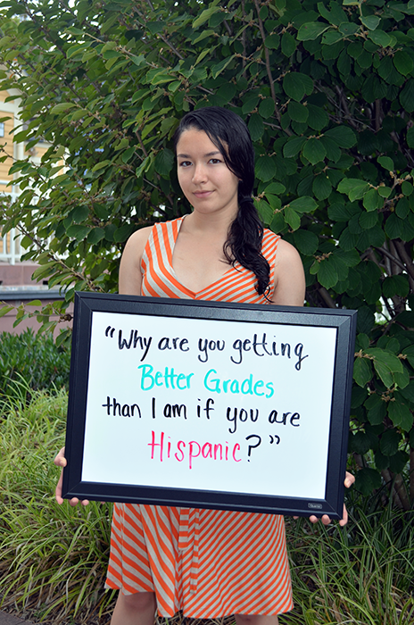
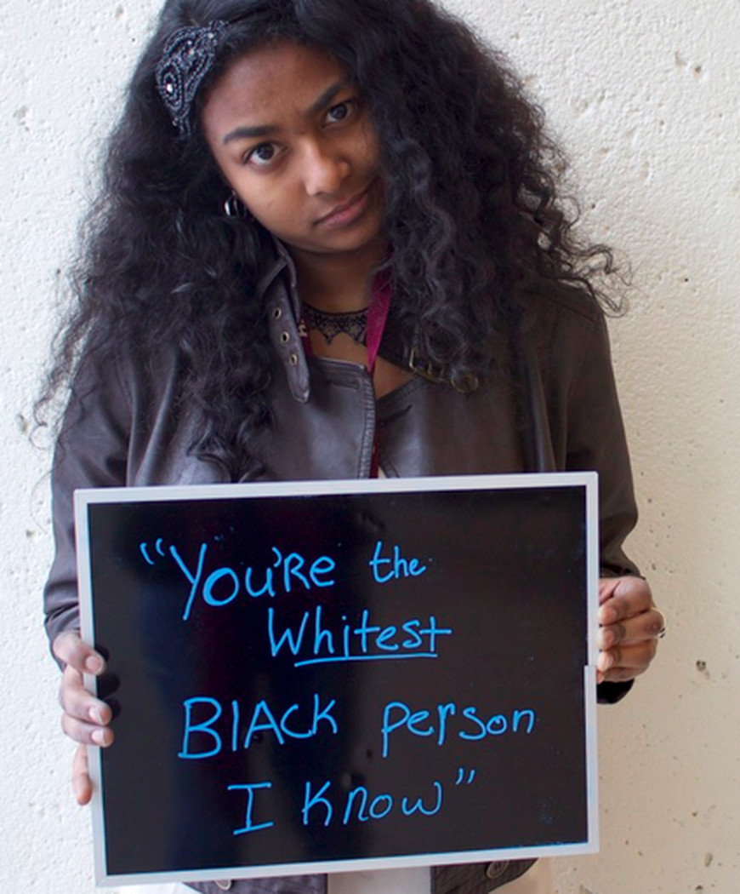
Quotes from Other Campuses
Notes:
Amie

Slide 19
What is the impact of microaggressions?
Fear
Anger
Frustration
Disbelief
Awkwardness
Discomfort
Unwelcome
Isolated
Invisible
Notes:
Amie

Slide 20
What about graduate students & faculty?
This conversation often focuses on undergraduate experiences.
In small groups discuss, what do microaggressions look like for faculty and graduate students?
Use the Jamboard to record your examples
Notes:
Amie

Slide 21
Does Intent Matter?
The impact of unintentional racism—the ways we participate in and bolster racism without actively trying to do so—is indistinguishable from the impact of intentional racism. Imagining myself as a good person, as a progressive person, means little if I am not examining and changing the impact I’m having even through actions I once took without intention.
- Paul Gorski, EdChange.org

Slide 22
Strategies to Address Microaggressions

Slide 23
Addressing Microaggressions
In the Jamboard, what are ways that you have learned to address microaggressions?
When you witness a microaggression?
When you’re the micro-aggressor?
Notes:
Ross

Slide 24
Responding to Microaggressions
Stay in the moment
Decide how to respond, when
Focus on the specific behavior
Share your concern about the impact
Request how you would like this to change, what you need in the future
Reflect on the experience
Notes:
Ross

Slide 25
Accepting Feedback Graciously
Feedback is a gift
Appreciate, consider the feedback
Acknowledge
Ask clarifying questions
Engage with humility
Stay present
Notes:
Ross

Slide 26
Focus on the Behavior
When somebody picks my pocket, I’m not going to be chasing them down so I can figure out whether he feels like he’s a thief deep down in his heart. I’m going to be chasing him down so I can get my wallet back. I don’t care what he is, but I need to hold him accountable for what he did.
That’s how we need to approach these conversations about race. Treat them like they took your wallet and focus on the part that matters, holding each person accountable for the impact of their words and actions.
- Jay Smooth, Ill Doctrine
This Photo by Unknown Author is licensed under CC BY-SA-NC
Notes:
Ross

Slide 27
Practicing our responses
In small groups, discuss your specific scenario.
What is going on here?
How can or should you respond?
Write how you would respond in the Jamboard.

Slide 28
Scenario One
While teaching a class, a student responds to the topic with some racial stereotypes and overgeneralizations. You can see a few of the students of color experience a visible reaction. What would you do?

Slide 29
Scenario Two
A group of instructors are commiserating about the challenges of teaching online. One of the instructors mentions a challenging experience navigating DRES accommodations with a student who missed several classes and was behind in their work. “If they can’t do the work, they should take an easier major.” What would you do?

Slide 30
Scenario Three
A student comes up to you during office hours. They are upset that a comment you made in class felt homophobic and transphobic. What would you do?

Slide 31
Scenario Four
A first-year doctoral student approaches you to discuss a conflict with their dissertation advisor. Their advisor is refusing to accept their dissertation proposal topic on histories of marginalized communities because the advisor is trained in text-based methods and uncomfortable with the research proposal using oral traditions. The student tells you that their topic requires this approach and is concerned that this rejection is racially motivated.

Slide 32
Scenario Debrief
What did you hear?
How would these strategies work in History?
How might we address the impact while also creating space for learning and growth?

Slide 33
Micro-affirmations and Micro-support
Micro-affirmations are “small acts in the workplace fostering inclusion, listening, comfort, and support for people who may feel unwelcome or invisible in an environment.”
How do you use micro-affirmations to “counter the harm” of microaggressions?

Slide 34
Micro-Affirmations in Action (Powell, Demetriou, & Fisher, 2013)
May be likely to occur through
Appreciative inquiry
Recognizing and validating experiences
Affirming feelings
Reinforcing and rewarding positive behaviors

Slide 35
Addressing Microaggressions as a Department
What can we each do to address microaggressions in History?

Slide 36
Next Steps
Department of History Diversity Committee (Chair Dr. Rana Hogarth)

Slide 37
Questions?

Slide 38
Office of the Vice Chancellor for Diversity, Equity & Inclusion
(217) 300-9580
http://diversity.illinois.edu
diversity@illinois.edu
Office of Access & Equity
ADA Division
Affirmative Action Division
Equal Employment Opportunity Division
Business, Community & Economic Development
Office of Academic Inclusive Excellence
Title IX Office

Slide 39
Contact Ross
Office of Academic Inclusive Excellence
Education & Training ● Equity Support ● Organizational Development
Ross Wantland
Director of Curriculum Development and Education
(217) 244-1814
wantland@illinois.edu
VISIT OUR NEW OFFICE
Suite 302, 614 E. Daniel St.

